Slide 1


WDT ~ Practical
Eng. Muhammad Saeed
Eng. Mohammed Abusarie
sinaiuniversity.net

Slide 2
Goals
Learn ASP.NET Core MVC
For building web apps using the Model-View-Controller design pattern.
@Sinaiunieg
info@su.edu.eg
www.su.edu.eg

Slide 3
Outline
C#
Basics
OOP
Advanced Topics
LINQ
Entity Framework
ASP.NET Core MVC
@Sinaiunieg
info@su.edu.eg
www.su.edu.eg

Slide 4
ASP.NET Core MVC (Steps)
@Sinaiunieg
info@su.edu.eg
www.su.edu.eg

Slide 5
Steps
Create MVC project + Github.
Add necessary packages.
Create Models
Create ApplicationDbContext class + DB Connection
Migrations
Create Controllers
Create Views
@Sinaiunieg
info@su.edu.eg
www.su.edu.eg

Slide 6
1. Create MVC Project
@Sinaiunieg
info@su.edu.eg
www.su.edu.eg

Slide 7
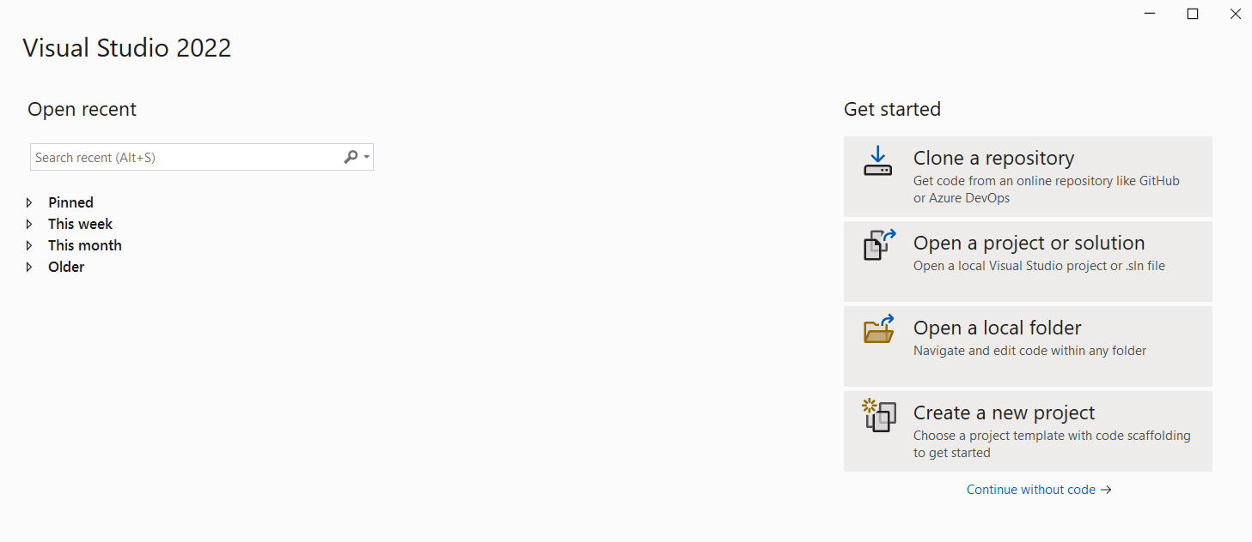
Create a Project
@Sinaiunieg
info@su.edu.eg
www.su.edu.eg

Slide 8
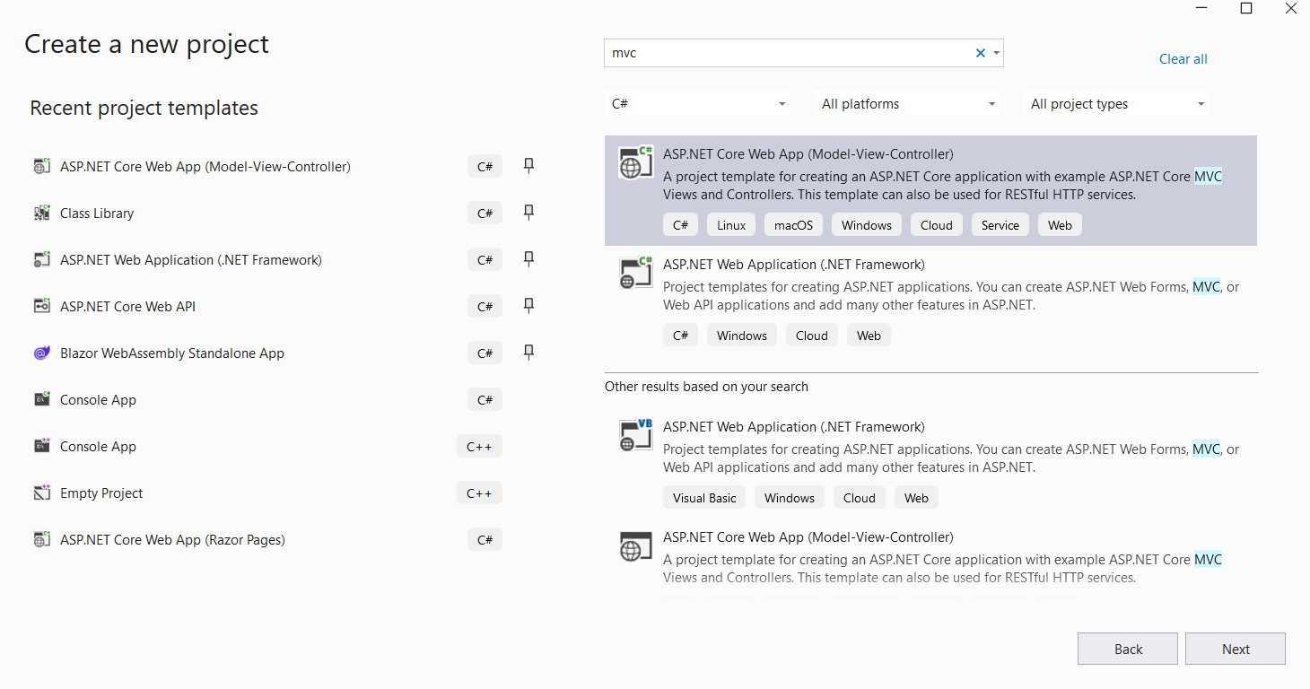
Create a Project
@Sinaiunieg
info@su.edu.eg
www.su.edu.eg

Slide 9
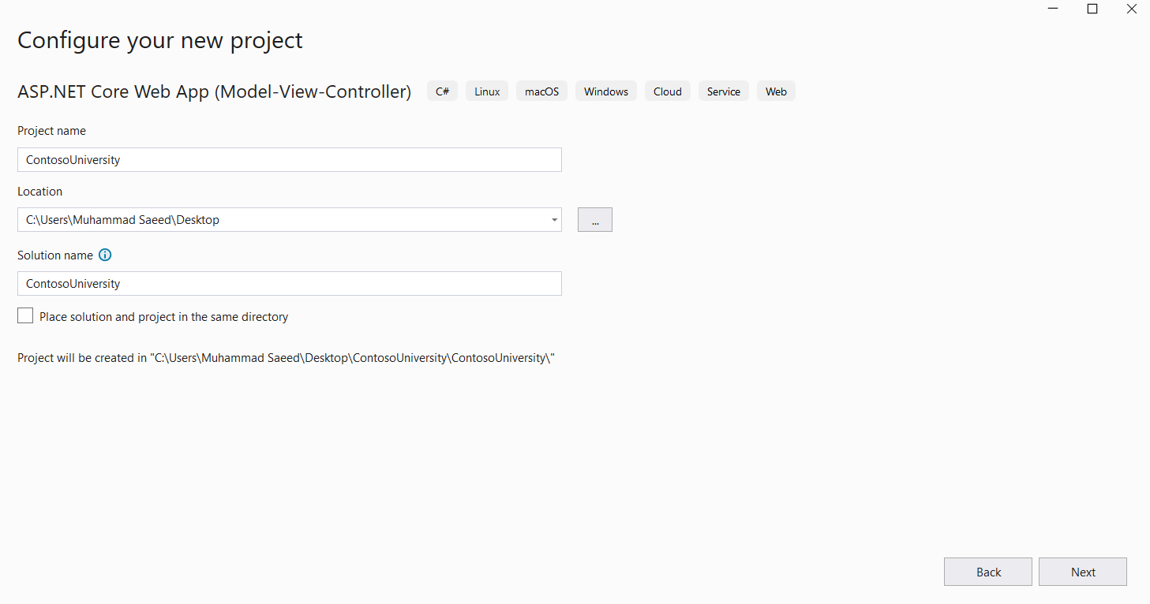
Create a Project
@Sinaiunieg
info@su.edu.eg
www.su.edu.eg

Slide 10
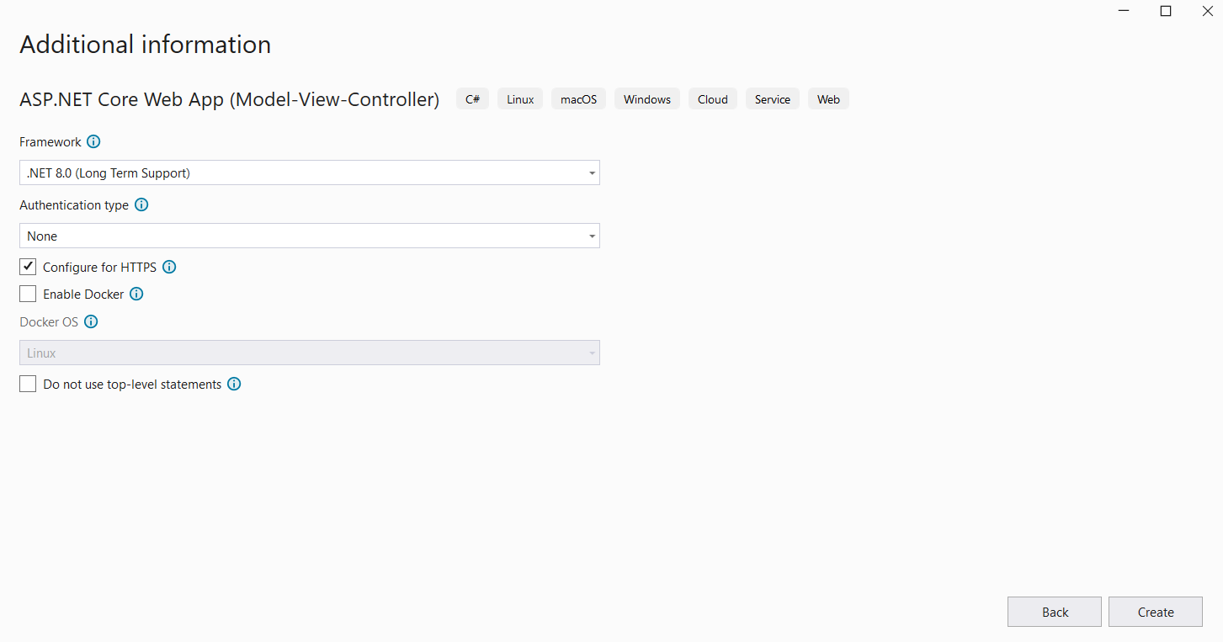
Create a Project
@Sinaiunieg
info@su.edu.eg
www.su.edu.eg

Slide 11
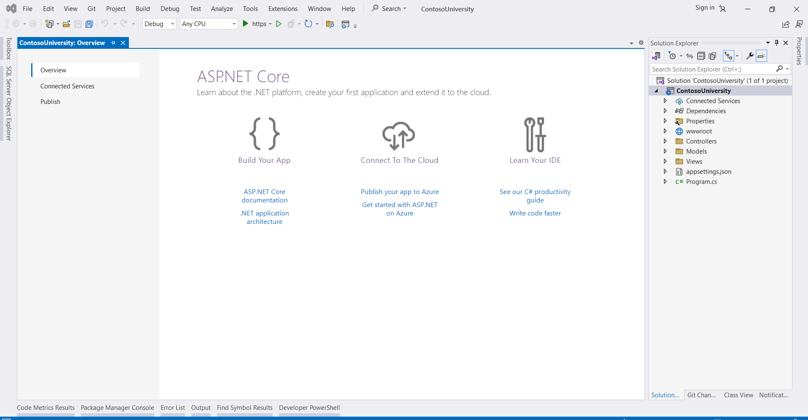
The Project
@Sinaiunieg
info@su.edu.eg
www.su.edu.eg

Slide 12
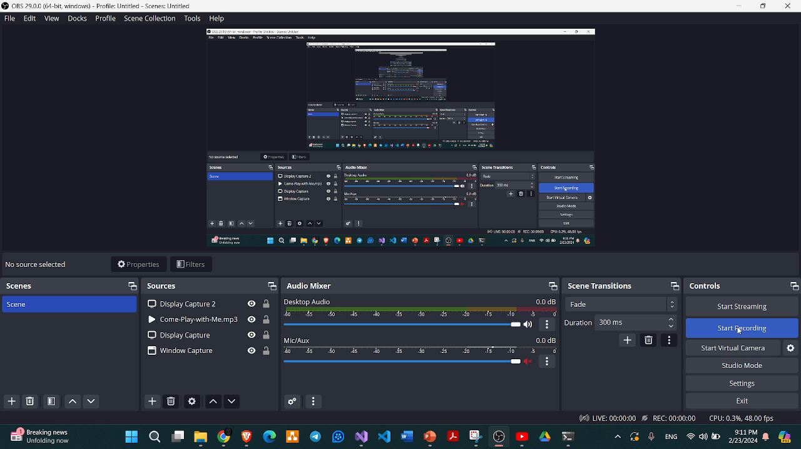
Github
@Sinaiunieg
info@su.edu.eg
www.su.edu.eg

Slide 13
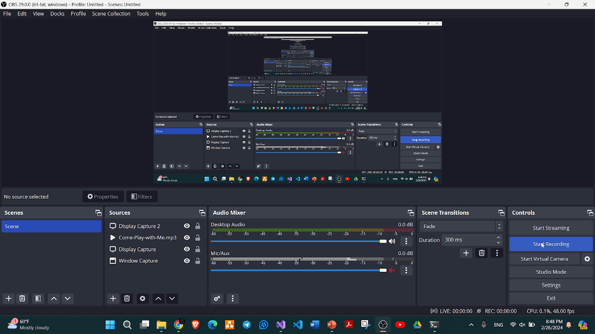
Github
@Sinaiunieg
info@su.edu.eg
www.su.edu.eg

Slide 14
2. Add necessary packages
@Sinaiunieg
info@su.edu.eg
www.su.edu.eg

Slide 15
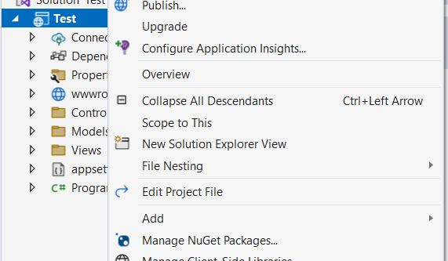
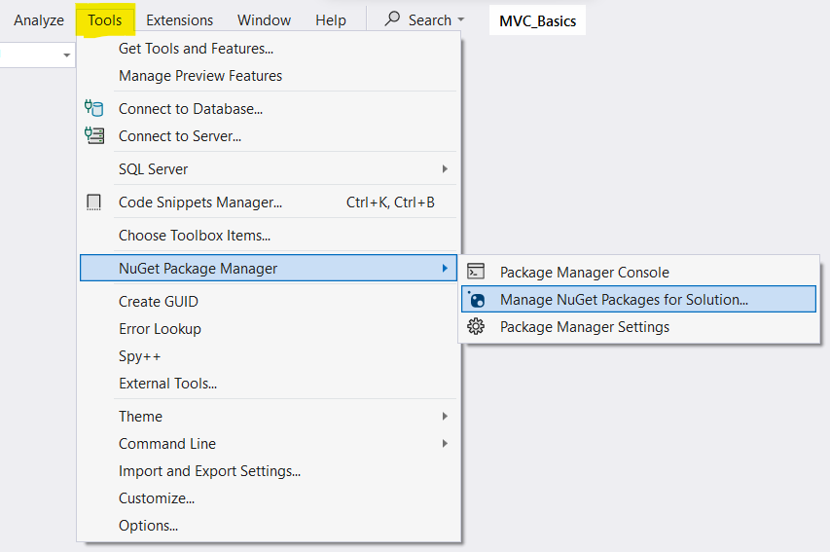
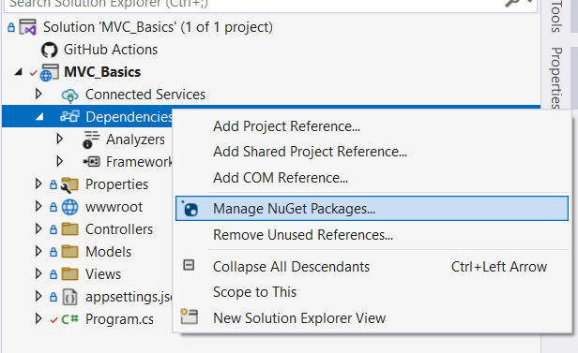
NuGet Package Manager
NuGet is the package manager for .NET. It enables you to add, remove, and update libraries/packages in your .NET projects.
@Sinaiunieg
info@su.edu.eg
www.su.edu.eg

Slide 16
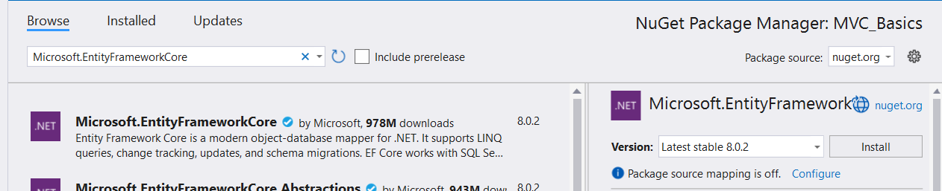
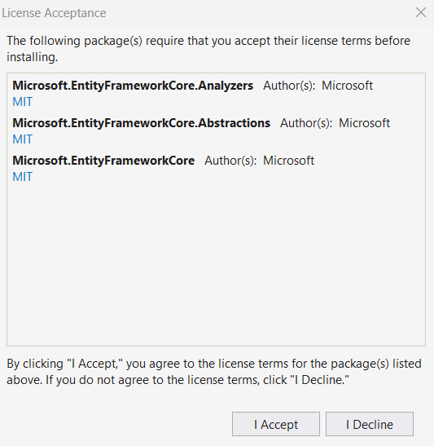
NuGet Package Manager
@Sinaiunieg
info@su.edu.eg
www.su.edu.eg

Slide 17
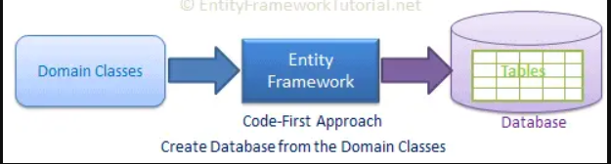
NuGet Package Manager
Packages
1. Microsoft.EntityFrameworkCore
To work with EF Core. It supports LINQ queries, change tracking, updates, and schema migrations.
Entity framework is an Object Relational Mapping (ORM) framework.
An ORM tool is software designed to help OOP developers interact with relational databases.
Creating DB and storing and accessing the data in the database.
@Sinaiunieg
info@su.edu.eg
www.su.edu.eg

Slide 18
NuGet Package Manager
Packages
2. Microsoft.EntityFrameworkCore.SqlServer
Provides support for SQL Server databases within EF Core.
3. Microsoft.EntityFrameworkCore.Tools
Enables some commands:
Add-Migration
Update-Database
Drop-Database
Remove-Migration
@Sinaiunieg
info@su.edu.eg
www.su.edu.eg

Slide 19
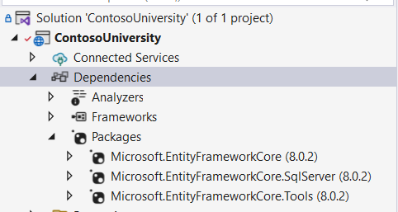
NuGet Package Manager
Packages
@Sinaiunieg
info@su.edu.eg
www.su.edu.eg

Slide 20
3. Create Models
@Sinaiunieg
info@su.edu.eg
www.su.edu.eg

Slide 21
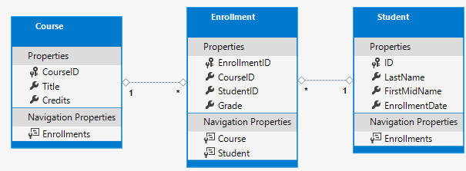
Models
Relationships:
A one-to-many relationship between Student and Enrollment entities.
A one-to-many relationship between Course and Enrollment entities.
@Sinaiunieg
info@su.edu.eg
www.su.edu.eg

Slide 22
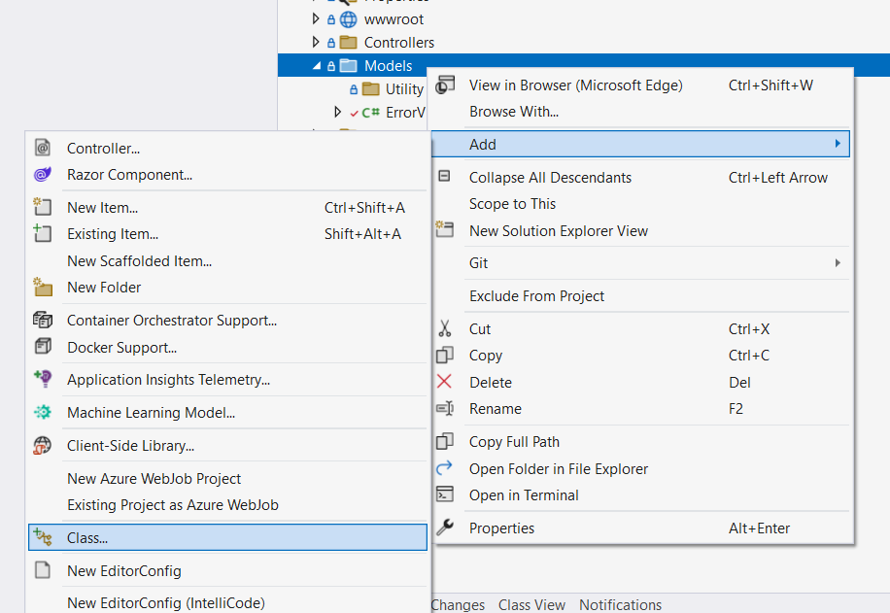
Create Student Model
@Sinaiunieg
info@su.edu.eg
www.su.edu.eg

Slide 23
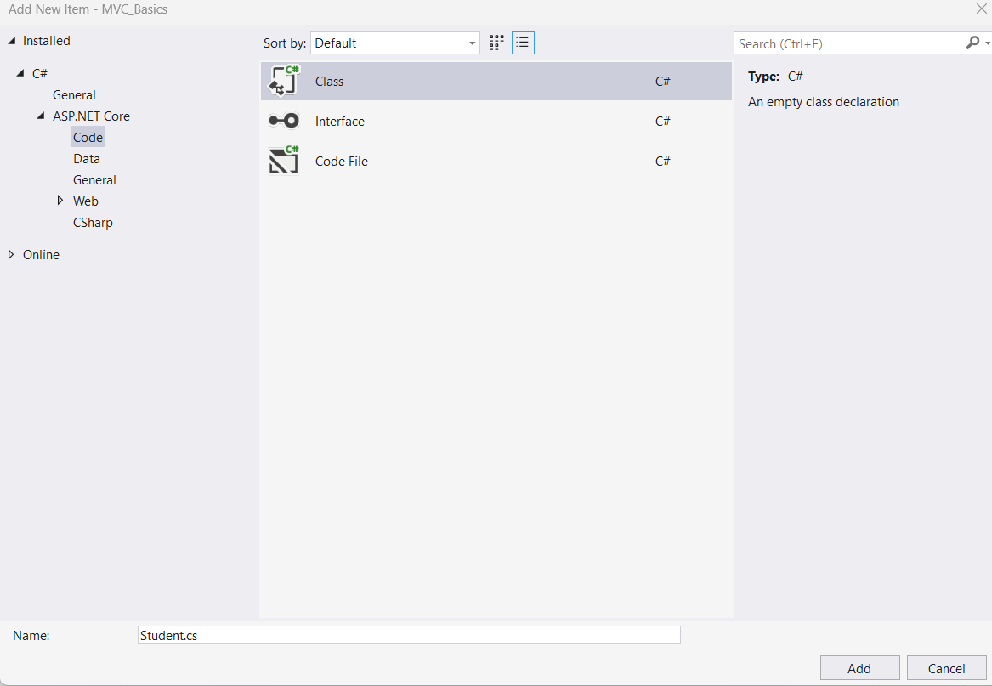
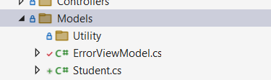
Create Student Model
@Sinaiunieg
info@su.edu.eg
www.su.edu.eg

Slide 24
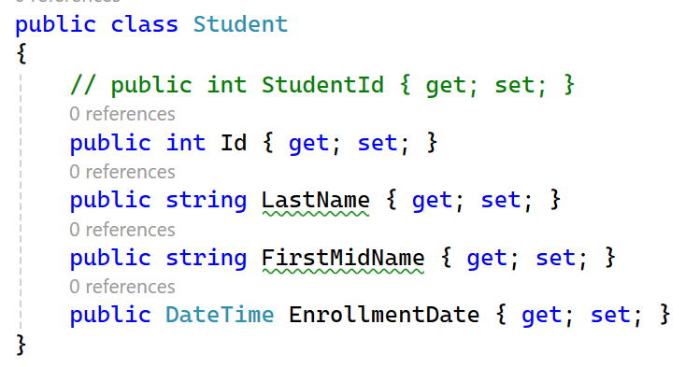
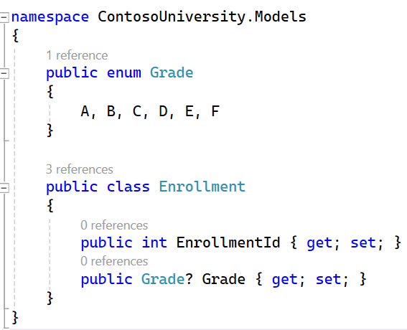
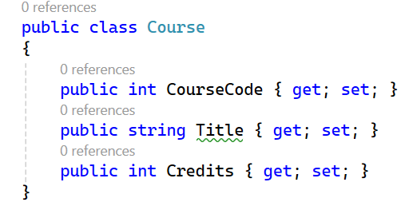
Create Models
A property = member or field + special methods called accessors
@Sinaiunieg
info@su.edu.eg
www.su.edu.eg

Slide 25
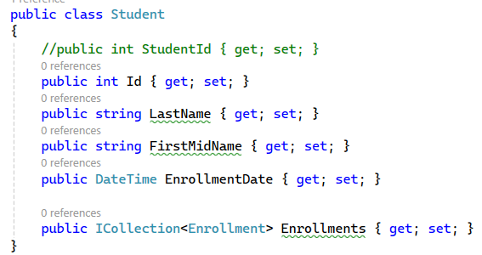
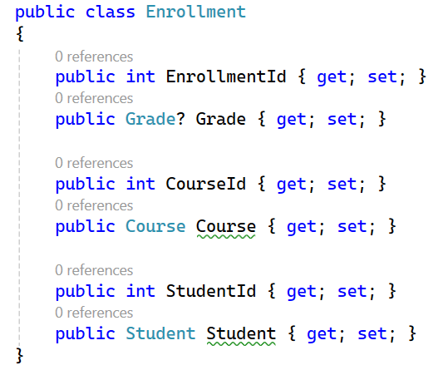
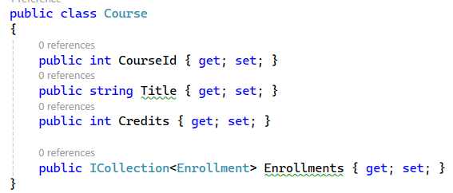
Add FKs and Navigation Properties
@Sinaiunieg
info@su.edu.eg
www.su.edu.eg

Slide 26
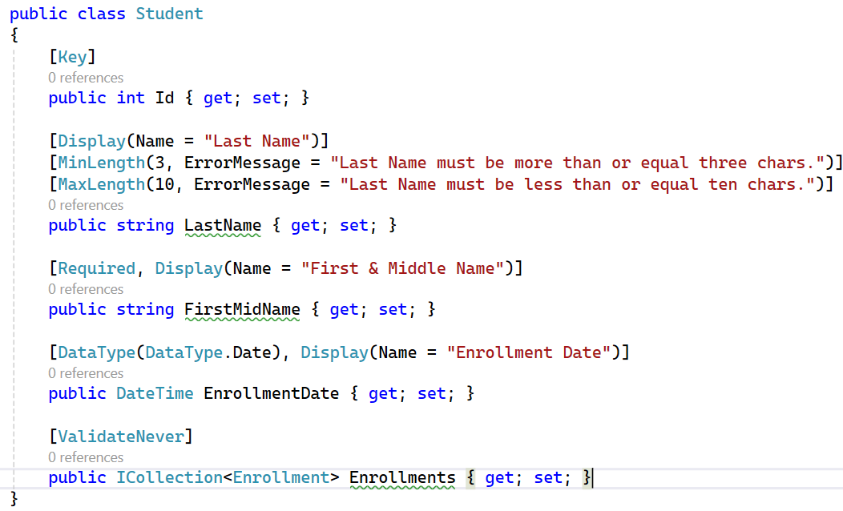
Data Annotation Attributes
@Sinaiunieg
info@su.edu.eg
www.su.edu.eg

Slide 27
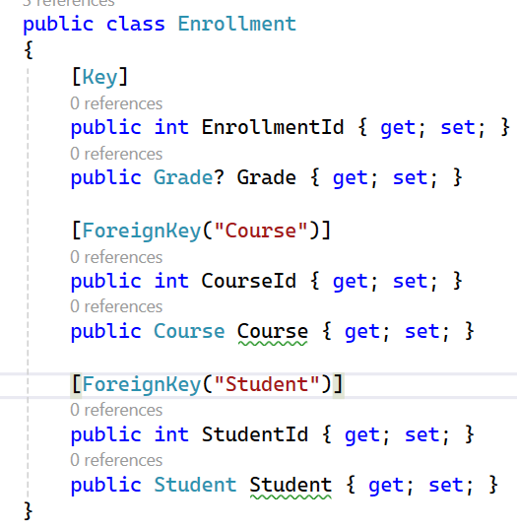
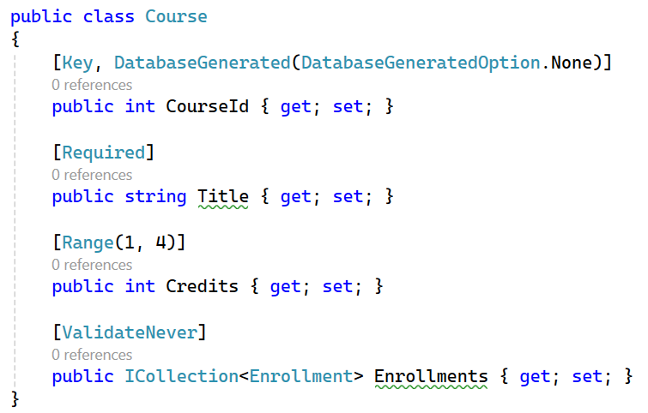
Data Annotation Attributes
@Sinaiunieg
info@su.edu.eg
www.su.edu.eg

Slide 28
4. Create ApplicationDbContext class
+
DB Connection
@Sinaiunieg
info@su.edu.eg
www.su.edu.eg

Slide 29
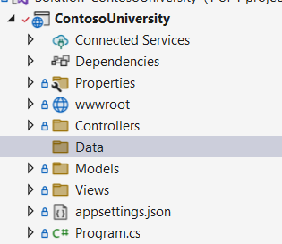
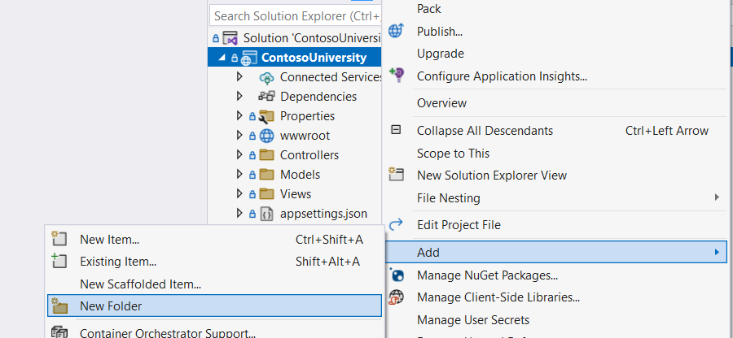
Create ApplicationDbContext class
The main class that coordinates EF functionality for a given data model is the DbContext (database context) class.
@Sinaiunieg
info@su.edu.eg
www.su.edu.eg

Slide 30
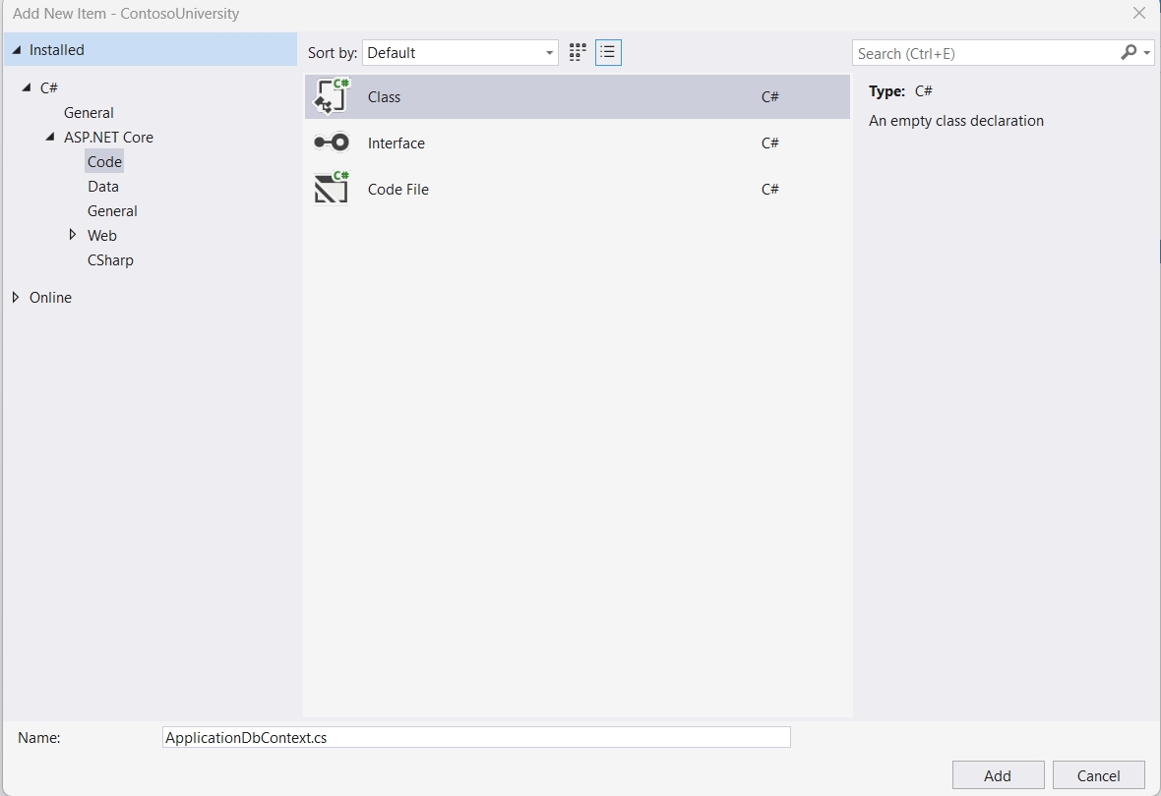
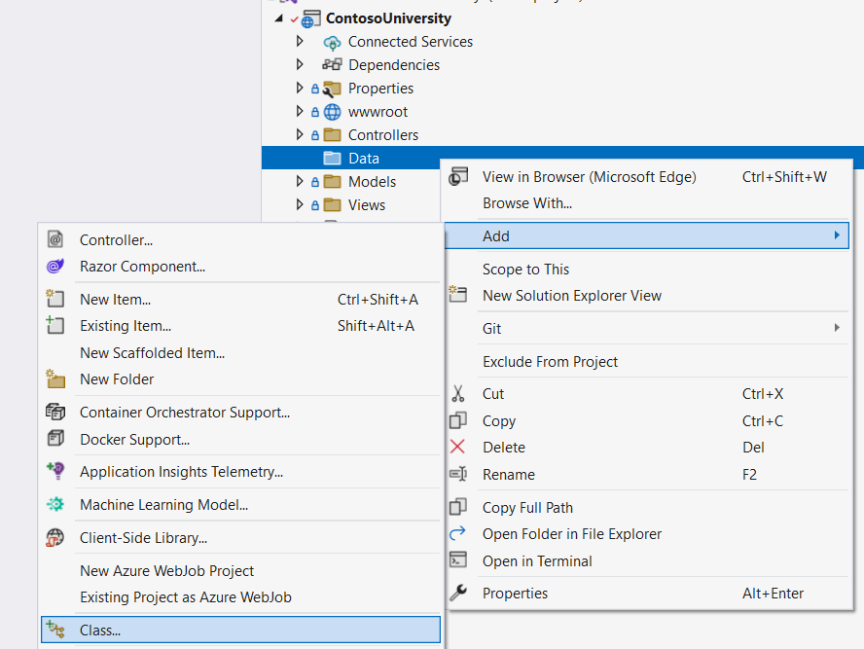
Create ApplicationDbContext class
@Sinaiunieg
info@su.edu.eg
www.su.edu.eg

Slide 31
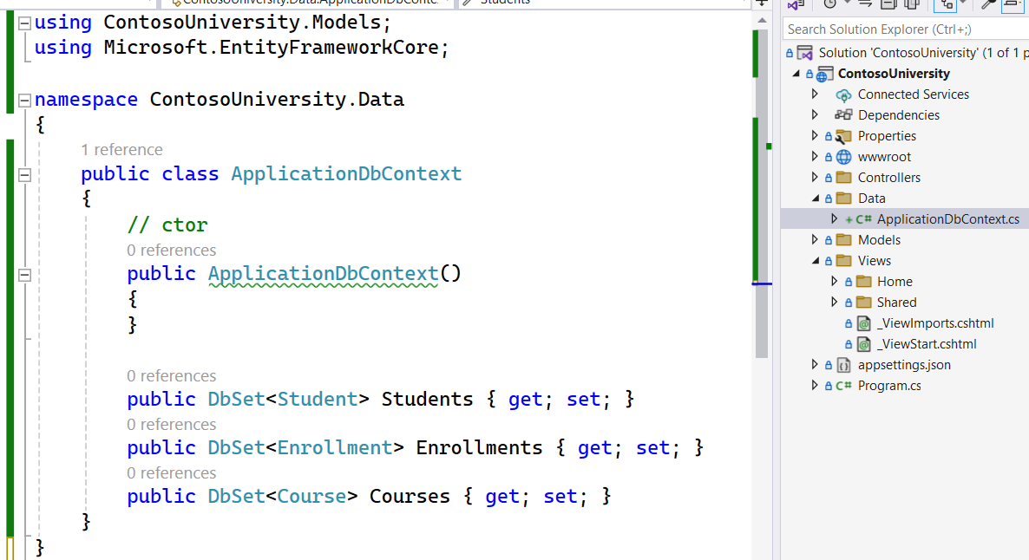
Create ApplicationDbContext class
@Sinaiunieg
info@su.edu.eg
www.su.edu.eg

Slide 32
Create ApplicationDbContext class
Note that:
- We create a DbSet property for each entity set.
- In EF terminology:
An entity set typically corresponds to a database table.
An entity corresponds to a row in the table.
- The DbSet<Enrollment> and DbSet<Course> statements could be omitted and it would work the same. EF would include them implicitly because:
The Student entity references the Enrollment entity.
The Enrollment entity references the Course entity.
@Sinaiunieg
info@su.edu.eg
www.su.edu.eg

Slide 33
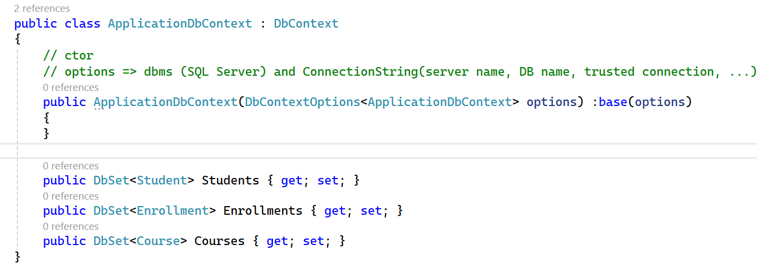
DB Connection
@Sinaiunieg
info@su.edu.eg
www.su.edu.eg

Slide 34
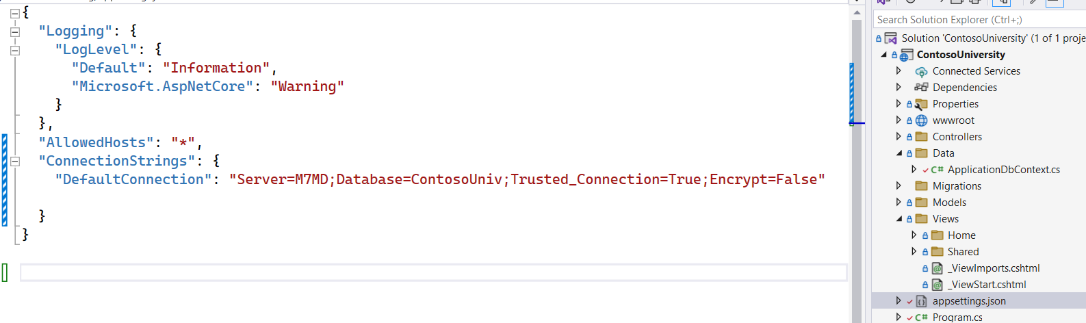
DB Connection
@Sinaiunieg
info@su.edu.eg
www.su.edu.eg

Slide 35
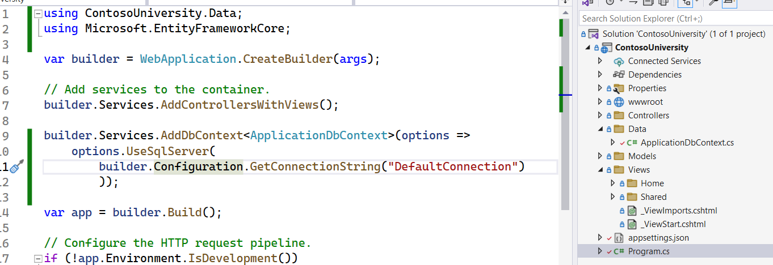
DB Connection
@Sinaiunieg
info@su.edu.eg
www.su.edu.eg

Slide 36
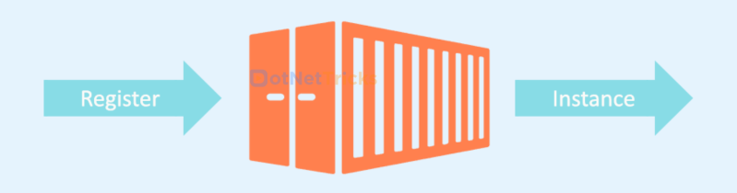
Understand program.cs
Dependency injection (also known as DI) is a design pattern that allows a class to receive its dependencies from an external source, rather than creating them internally.
The specific approach we utilize is known as the Constructor Injection.
ApplicationDbContext is registered as a service.
A service is a reusable part of the code that adds some functionality to our application.
DI Container/Services Container
@Sinaiunieg
info@su.edu.eg
www.su.edu.eg

Slide 37
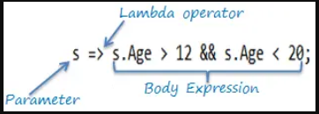
Understand program.cs
Advanced Topic (Lambda Expression)
Lambda Expression is a short block of code that accepts parameters and returns a value.
It is defined as an anonymous function (function without a name). The lambda expression does not execute on its own. Instead, we use it inside other methods or variables.
All lambda expressions use the lambda operator =>, which can be read as “goes to” or “becomes”.
Parameter => expression
Parameter => { statements };
Count => count + 2;
Sum => sum + 2;
n => n % 2 == 0
@Sinaiunieg
info@su.edu.eg
www.su.edu.eg

Slide 38
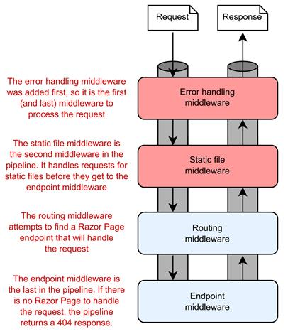
Understand program.cs
Middleware
ASP.NET Core middleware is a piece of code integrated inside the application’s pipeline that we can use to handle requests and responses.
We can think of it as a code section that executes with every request.
@Sinaiunieg
info@su.edu.eg
www.su.edu.eg

Slide 39
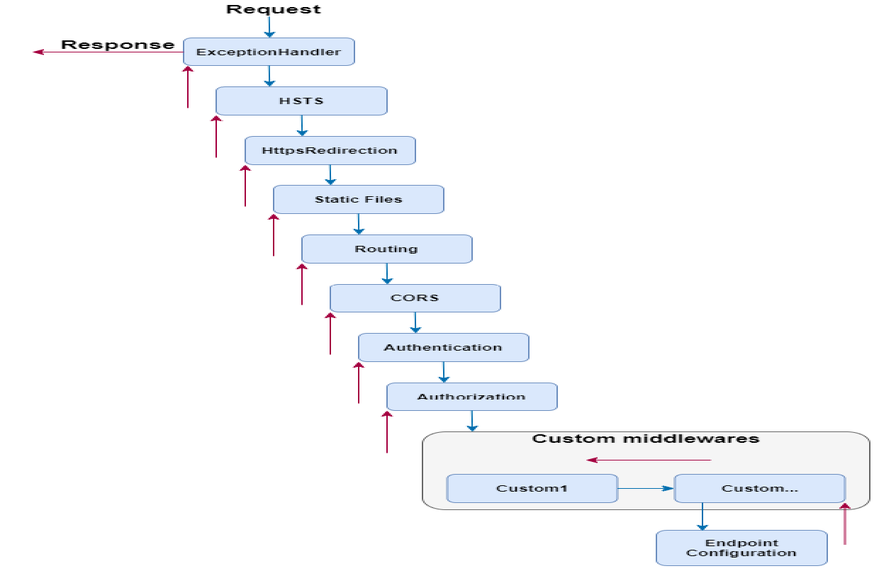

Understand program.cs
@Sinaiunieg
info@su.edu.eg
www.su.edu.eg

Slide 40
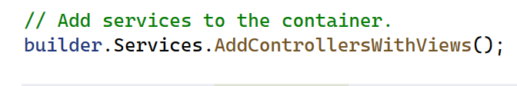
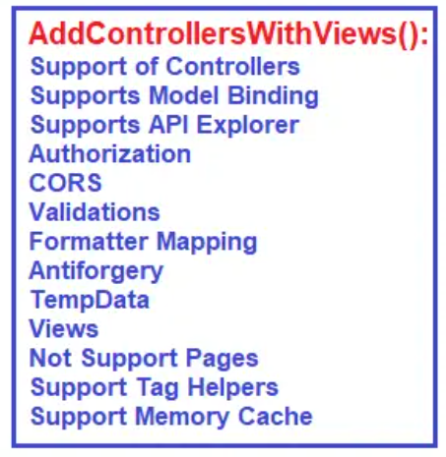
Understand program.cs
@Sinaiunieg
info@su.edu.eg
www.su.edu.eg

Slide 41
5. Migrations
@Sinaiunieg
info@su.edu.eg
www.su.edu.eg

Slide 42
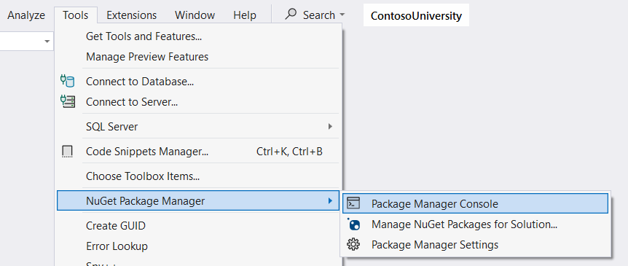
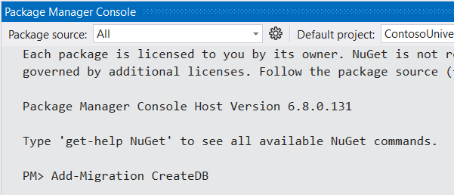
Migrations
1. Add Migration
@Sinaiunieg
info@su.edu.eg
www.su.edu.eg

Slide 43
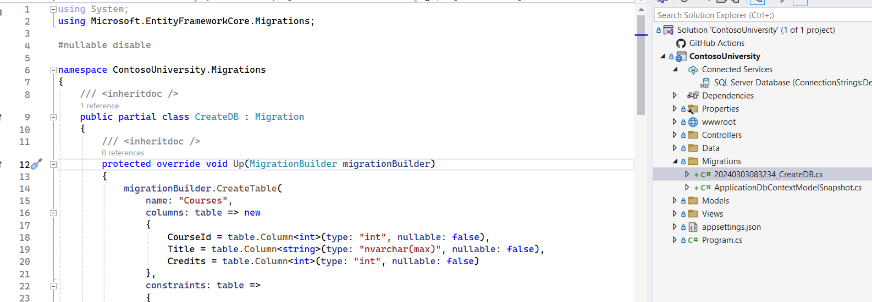
Migrations
1. Add Migration
@Sinaiunieg
info@su.edu.eg
www.su.edu.eg

Slide 44
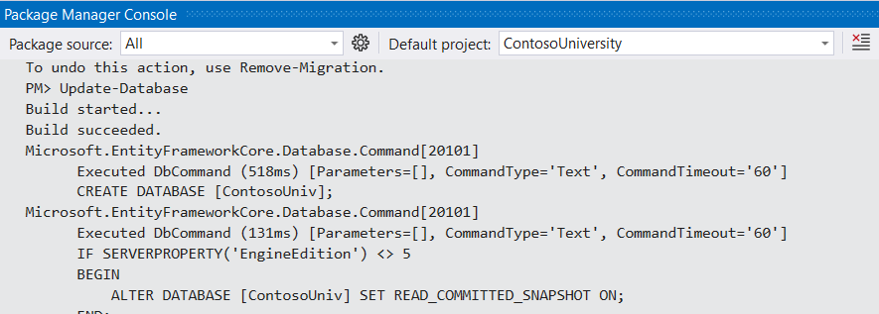
Migrations
2. Update-Database
@Sinaiunieg
info@su.edu.eg
www.su.edu.eg

Slide 45
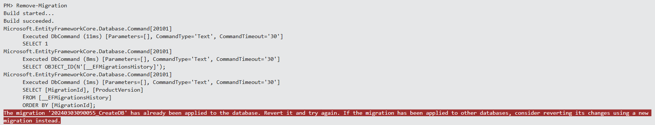
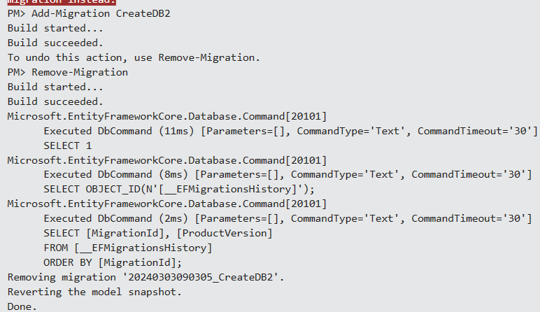
Migrations
3. Remove-Migration
@Sinaiunieg
info@su.edu.eg
www.su.edu.eg

Slide 46
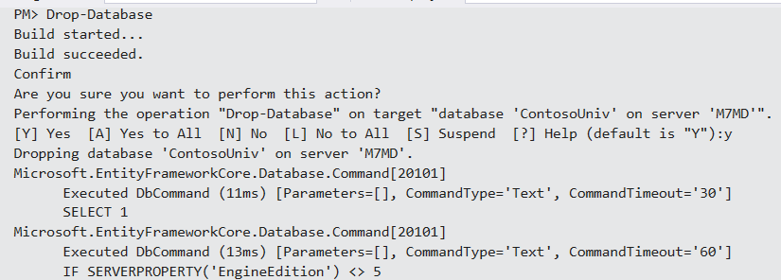
Migrations
4. Drop-Database
@Sinaiunieg
info@su.edu.eg
www.su.edu.eg

Slide 47
6. Create Controllers
@Sinaiunieg
info@su.edu.eg
www.su.edu.eg

Slide 48
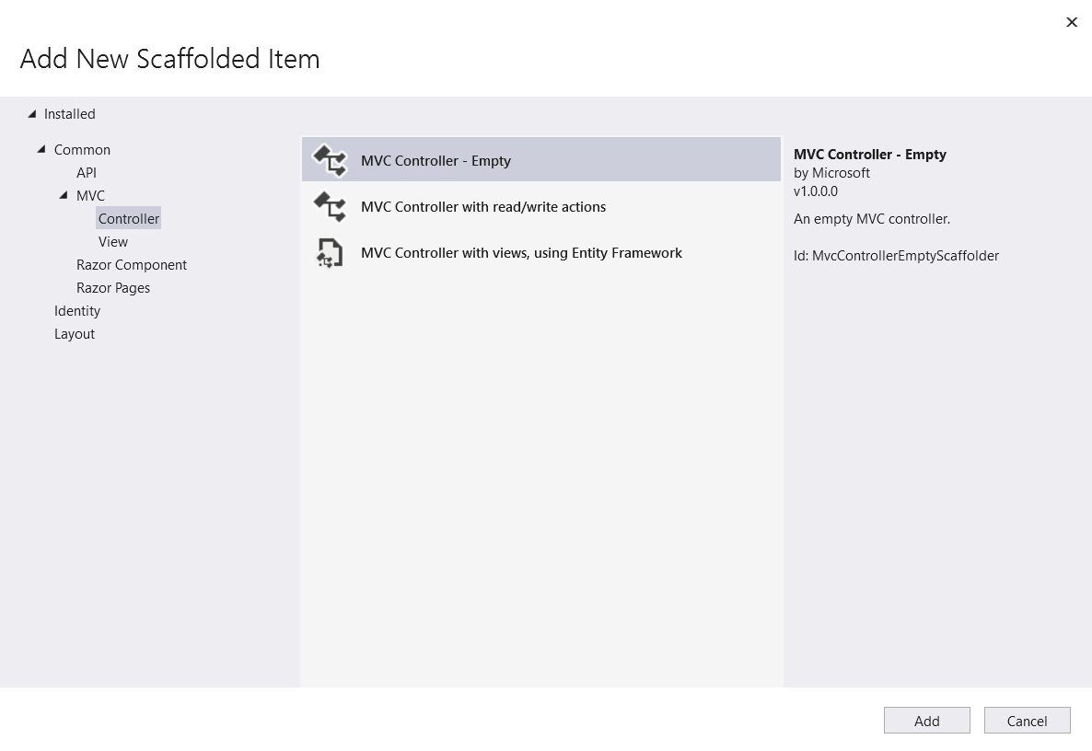
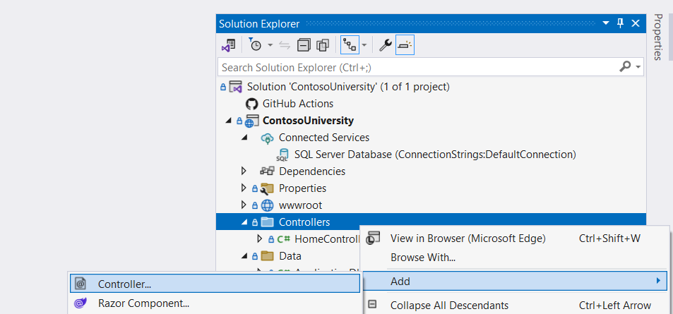
Create Student Controller
@Sinaiunieg
info@su.edu.eg
www.su.edu.eg

Slide 49


Create Student Controller
@Sinaiunieg
info@su.edu.eg
www.su.edu.eg

Slide 50

Create Student Controller
1. Add student constructor and inject ApplicationDbContext
@Sinaiunieg
info@su.edu.eg
www.su.edu.eg

Slide 51

CRUD Operations
@Sinaiunieg
info@su.edu.eg
www.su.edu.eg

Slide 52

Create Student Controller
2. Retrieve All Students (Index Action)
@Sinaiunieg
info@su.edu.eg
www.su.edu.eg

Slide 53

Create Student Controller
2. Create Action (Without Model Binding )
@Sinaiunieg
info@su.edu.eg
www.su.edu.eg

Slide 54


Model Binding
The Model binding is the process of mapping the data posted over an HTTP request to the parameters of the action method in the Controller.
@Sinaiunieg
info@su.edu.eg
www.su.edu.eg

Slide 55

Create Student Controller
2. Create Action (With Model Binding)
@Sinaiunieg
info@su.edu.eg
www.su.edu.eg

Slide 56

Create Student Controller
3. Details Action
@Sinaiunieg
info@su.edu.eg
www.su.edu.eg

Slide 57

Create Student Controller
4. Edit Action
@Sinaiunieg
info@su.edu.eg
www.su.edu.eg

Slide 58

Create Student Controller
5. Delete Action
@Sinaiunieg
info@su.edu.eg
www.su.edu.eg

Slide 59
7. Create Views
@Sinaiunieg
info@su.edu.eg
www.su.edu.eg

Slide 60


Tag Helpers
ASP.NET Core Tag Helpers are a tagging tool that allow you to dynamically add behaviors and attributes to HTML elements in an ASP.NET Core MVC application. Tag Helpers enable server-side code to participate in creating and rendering HTML elements in Razor files.
In order to use tag helpers in an application, we must make them available in our application by adding them with the @addTagHelper directive.
@Sinaiunieg
info@su.edu.eg
www.su.edu.eg

Slide 61

Tag Helpers
1. Change _Layout.cshtml
@Sinaiunieg
info@su.edu.eg
www.su.edu.eg

Slide 62


Create Views
1. Index View
@Sinaiunieg
info@su.edu.eg
www.su.edu.eg

Slide 63


Create Views
1. Index View
@Sinaiunieg
info@su.edu.eg
www.su.edu.eg

Slide 64

Create Views
1. Index View
@Sinaiunieg
info@su.edu.eg
www.su.edu.eg

Slide 65

Create Views
2. Create View (Without Model Binding )
@Sinaiunieg
info@su.edu.eg
www.su.edu.eg

Slide 66

Create Views
Update Index View
@Sinaiunieg
info@su.edu.eg
www.su.edu.eg

Slide 67

Create Views
2. Create View
@Sinaiunieg
info@su.edu.eg
www.su.edu.eg

Slide 68

Create Views
3. Details View
@Sinaiunieg
info@su.edu.eg
www.su.edu.eg

Slide 69

Create Views
Update Index View
@Sinaiunieg
info@su.edu.eg
www.su.edu.eg

Slide 70

Create Views
4. Edit View
@Sinaiunieg
info@su.edu.eg
www.su.edu.eg

Slide 71

Create Views
Update Index View
@Sinaiunieg
info@su.edu.eg
www.su.edu.eg

Slide 72

Create Views
5. Delete View
@Sinaiunieg
info@su.edu.eg
www.su.edu.eg

Slide 73

Create Views
Update Index View
@Sinaiunieg
info@su.edu.eg
www.su.edu.eg

Slide 74


Views
@Sinaiunieg
info@su.edu.eg
www.su.edu.eg

Slide 75



Views
@Sinaiunieg
info@su.edu.eg
www.su.edu.eg

Slide 76

THANK YOU
muhammad.saeed@su.edu.eg
Eng. Muhammad Saeed

